Slide 1



Day 5 –
Gradient Boosting with XGBoost
An Introduction to Advanced Machine Learning Techniques
Presented by:
Dr Grace U. Nneji
Dr Happy N. Monday

Slide 2




Objectives
Understand gradient boosting concepts
Train & tune an XGBoost model
Visualize learning curves & feature importance
Save model for energy‑prediction dashboard

Slide 3




Understanding Gradient Boosting Concepts
The basic principle of gradient boosting explained simply
Gradient boosting is a powerful method that combines multiple weak learners to create a strong predictive model through iterative improvements.
How gradient boosting minimizes errors in predictions
By focusing on the mistakes of previous models, gradient boosting effectively reduces residual errors, leading to more accurate predictions in complex datasets.
Key components that make gradient boosting effective
Gradient boosting relies on decision trees, learning rates, and loss functions to refine predictions, enabling it to adapt effectively to different data patterns.

Slide 4
Gradient Boosting is a machine learning technique that builds an ensemble of decision trees sequentially, where each new tree attempts to correct the errors (residuals) made by the previous trees.
Key Terms
Weak Learner: A model that performs slightly better than random guessing.
Ensemble: A combination of multiple models to improve overall performance.
Residual: The difference between the actual and predicted value.
Learning Rate: A scaling factor that controls how much each new model affects the final prediction.

Slide 5
Why Choose XGBoost for Machine Learning?
High Performance and Speed in Training Models
XGBoost offers exponential speed in training, allowing models to be built quickly and efficiently, making it a favorite among data scientists.
Handles Missing Values Effectively with Built-in Strategies
XGBoost's ability to manage missing data automatically helps improve model accuracy without significant preprocessing efforts, saving valuable time.
Robust Regularization to Prevent Overfitting Issues
With built-in L1 and L2 regularization, XGBoost effectively reduces overfitting, leading to improved generalization on unseen data, which is essential for reliable predictions.

Slide 6
Installing XGBoost Made Easy
A step-by-step guide to install XGBoost and access its official documentation for users.
https://xgboost.readthedocs.io/en/latest/
To get started with XGBoost, you need to install the package using the following command in your terminal.
This ensures a smooth setup.
pip install xgboost

Slide 7
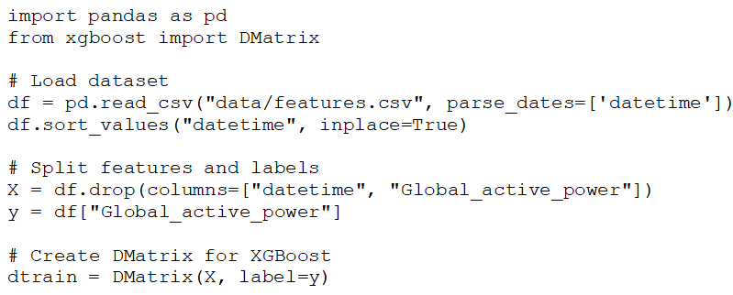
Loading Data & Prepare Inputs
We use the features created in Day 3
A DMatrix is XGBoost's internal optimized data structure, used to store features and labels efficiently for training.

Slide 8
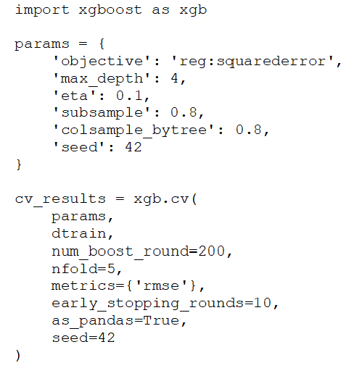
Cross-Validation with xgboost.cv()
Cross-validation helps avoid overfitting and gives insight into the model’s generalization ability

Slide 9
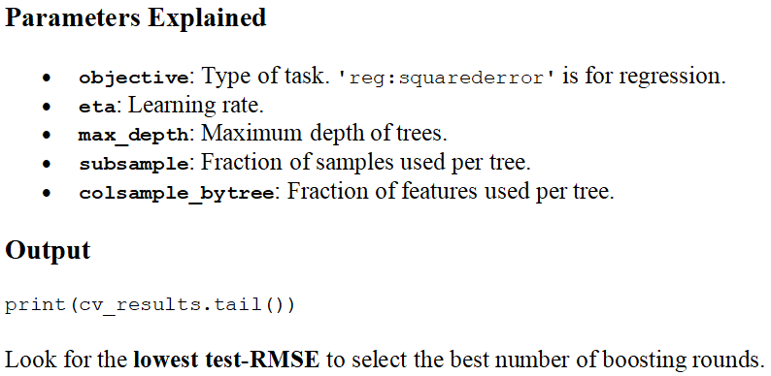
Cross-Validation with xgboost.cv()

Slide 10
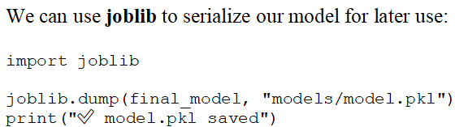
Fit and Save Your Model Effectively
Learn how to properly fit and save your XGBoost model for future use in machine learning projects.
Fitting the model is crucial for optimal performance. Once fitted, you can save your model to reuse it without retraining.

Slide 11
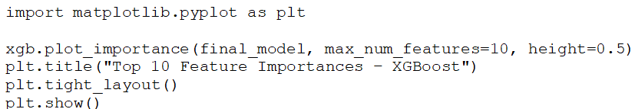
Understanding XGBoost Result Visualizations
Explore how to interpret and utilize visualizations to enhance model comprehension and performance analysis for Machine Learning.
Visualizations are crucial in understanding model performance. They help in identifying patterns and improving our machine learning models for better predictions.

Slide 12
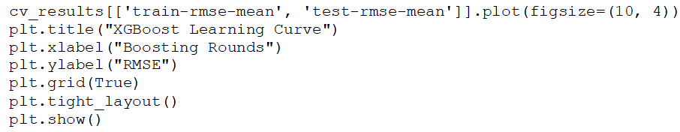
Plot Learning Curve

